Slide 1
Docker Workshop
Nitin Vashisth
Christian Diemer
Smith Agarwal

Slide 2

Problem with regular deployment of application ? 1. OS Dependent 2. Not Scalable 3. Not Portable 4. Lot more …

Slide 3
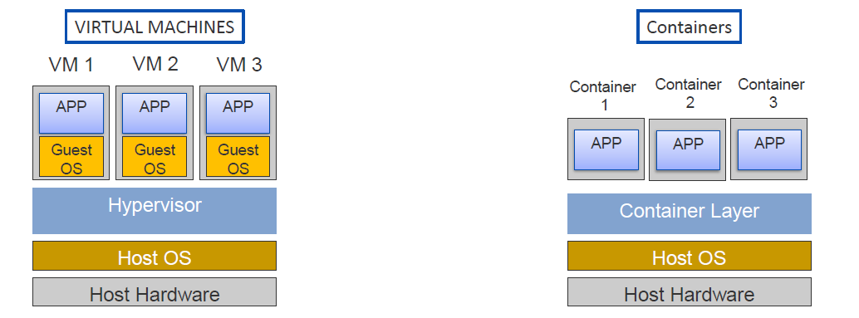
Containerization

Slide 4
How this containerization can be achieved?

Slide 5
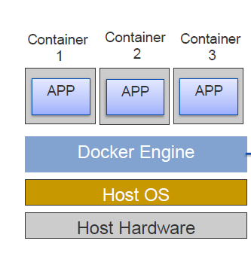
Docker
Notes:
Machine-learning starts with the data used to train the model. Let's talk about where you can find interesting datasets, and how you load them into ML Studio.

Slide 6
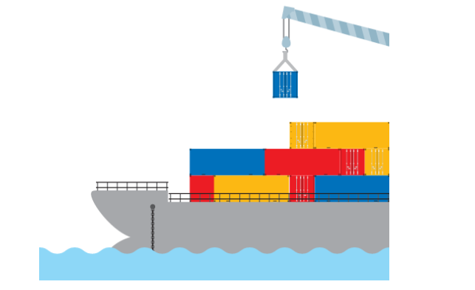
Why Containers?
In real world, if a country wants to export any luggage to another country, they put them into a container then they ship that container either by road or through a dock to another country
Notes:
There are a variety of ways to get data into ML Studio. Of course, that begs the question of where you obtain interesting datasets in the first place. ML Studio includes a number of sample datasets that you can use. In addition, you can download data from public repositories such as kaggle.com, the UCI Machine Learning Repository (https://archive.ics.uci.edu/ml/datasets.html), and various government Web sites, including the Bureau of Transportation Statistics (https://www.transtats.bts.gov/). Data is everywhere. And much of it is freely available.

Slide 7
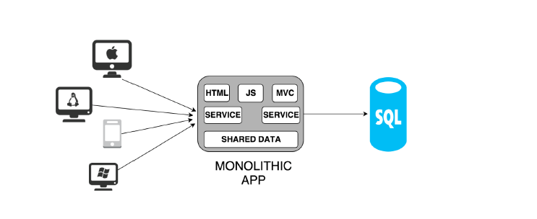
Monolithic Architecture
Notes:
It is a typical server side application with layered structure, where everything is bundled into single monolith.

Slide 8
Disadvantage
Too large and Complex
Limitation in size and complexity
Slow start time
Re-deployment of complete application on update
Difficult in scaling
Reliability
Notes:
Work Exercise 1 of the challenge and invite students to follow along with you. Take time to explore the dataset and discuss which features might be appropriate to include in a model, and which ones might not. For example, you would not want to include the DEP_DELAY column in a machine-learning model, because while there is probably a strong correlation between flights that are delayed at departure and flights that arrive late, you don't know when you book a flight whether its departure will be delayed. By contrast, it WOULD make sense to include scheduled departure time (CRS_DEP_TIME) in a model, because flights earlier in the day tend to be more on time than flights later in the day.

Slide 9
How can we solve these problems?

Slide 10
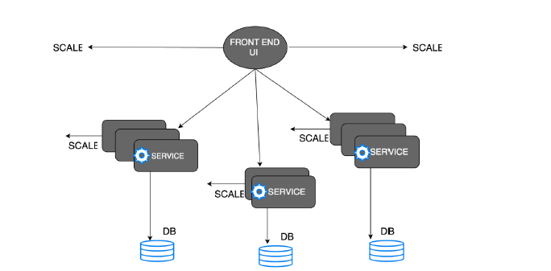
Microservice Architecture
Notes:
The idea here is to split the application into a set of smaller, interconnected services.
Every Service :-
•intercommunicates with a common communication protocol like REST webservice with JSON.
•run in dividually either in single machine or different machine, but they execute its own separate process.
•may have own database or storage system, or they can share common database or storage system.

Slide 11
Let us see how can we implement Microservice architecture by containerization
Notes:
Data scientists often spend 50% or more of the time building a machine-learning model getting the data ready for training by filtering out columns that aren't relevant to the analysis (or that would bias the results), removing rows with missing data or algorithmically filling in missing data, removing duplicate rows from the dataset, etc. ML Studio includes several modules for performing such tasks. It even includes modules for helping select the columns or "features" that have the greatest statistical influence on the outcome.

Slide 12
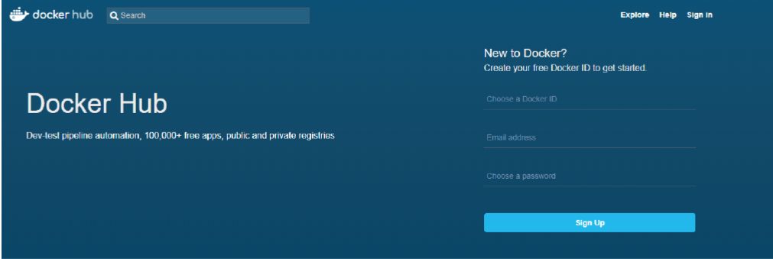
Docker Hub
Notes:
•Cloud-based registry service
•Allows you to link to code repositories, build your images, stores manually pushed images, and links to Docker Cloud so you can deploy images to your hosts.
•It provides a centralized resource for container image discovery, distribution and management

Slide 13
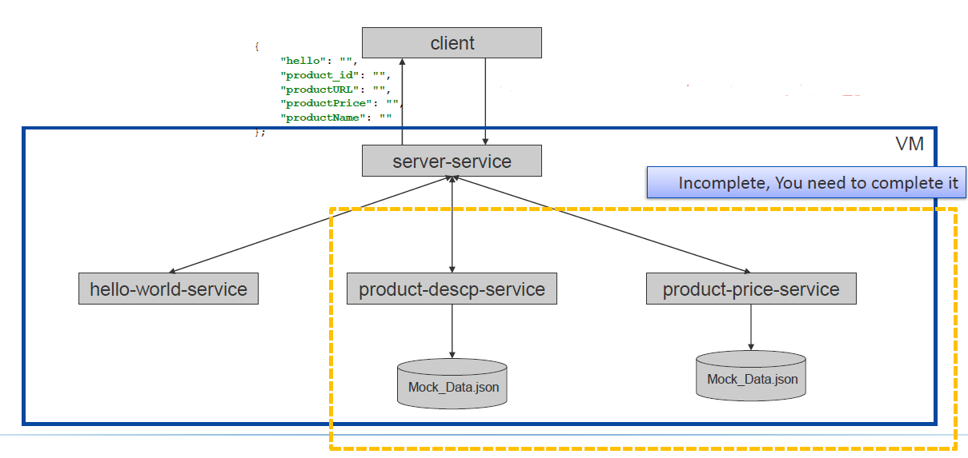
Big overview of our exercise
Notes:
The Azure ML Cheat Sheet helps you pick the right algorithm for a model, even if you're not a trained data scientist. One example is if you want to use a set of input values to predict an output value from a continuous set of values (e.g., a person's age), use linear regression. But if you're more interested in the distribution of the output, you might use fast forest quantile regression instead. An example of when you would use the latter is using growth charts to assess child development. "Abby's height is in the 10% quantile of the heights of kids her age." Classification algorithms, by contrast, are used to predict a value from a discrete set of values -- for example, classifying an e-mail as spam or not spam.

Slide 14
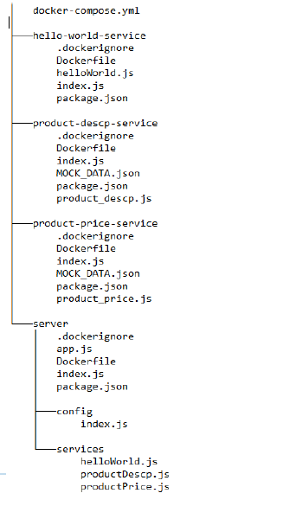
← Directory structure

Slide 15
Demo
Notes:
Work Exercise 2 of the challenge and invite students to follow along with you.

Slide 16
Implement now !
Complete the microservice product description service (to get product name and URL) and product price service (to get the product price)
2. Files which need to be completed
product-price-service/product_price.js
server/services/product_price.js
product-descp-service/product_descp.js
server/services/product_descp.js
docker-compose.yml(addyourdockerhubid)
Notes:
The visualizations provided by Evaluate Model differ depending on the algorithm you use. The example above charts a key metric used to evaluate two-class classification models called AUC, which is short for Area Under Curve. The greater the area under the curve (the one above represents 0.92, or 92%), the more accurate the predictive model. The diagonal line represents 50% accuracy, which is basically what you would get by flipping a coin.

